Slide 1

International Diversity in Scientific Outputs and Reviews
Vera Kempe
Abertay University Dundee

Slide 2
Why International Diversity?
Biased distribution of authors, reviewers and editors in ‘international’ journals
Increase in reviewer fatigue
Limited epistemic diversity

Slide 3
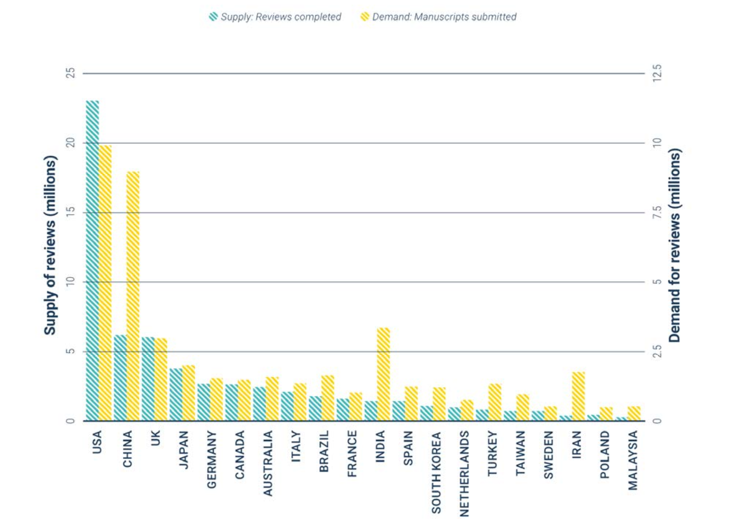
Supply =
reviews
completed
Demand =
manuscripts
submitted
25
12.5
USA:
33% reviews
25% papers
20
10
15
7.5
Supply of reviews (millions)
Demand of reviews (millions)
10
5
5
2.5
0
0
2013-2017
Publons Global State of Peer Review Report (2018)
Notes:
Both research outputs and reviews are unevenly distributed across countries. Note the difference in scale between reviews (left) and submitted papers (right). The USA dominates absolute contributions to peer review, contributing 32.9% of all reviews compared to 25.4% of published article output.

Slide 4
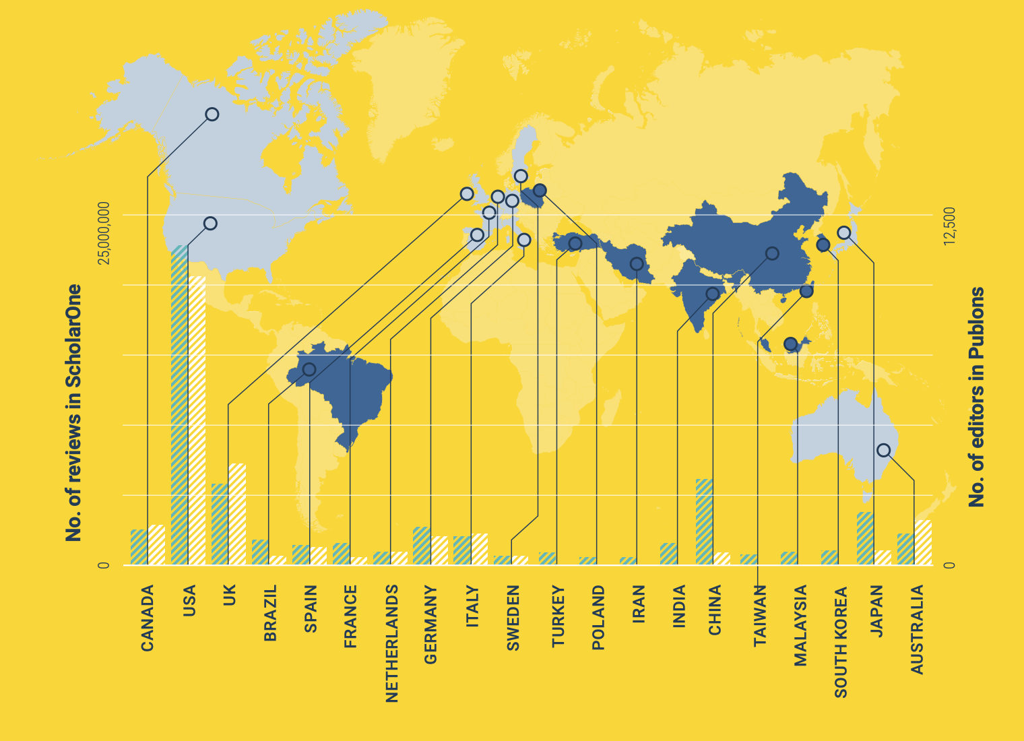

96.1%
of editors are from established regions.
Publons Global State of Peer Review Report (2018)
Notes:
Why? Editors are predominantly selected from established regions…

Slide 5
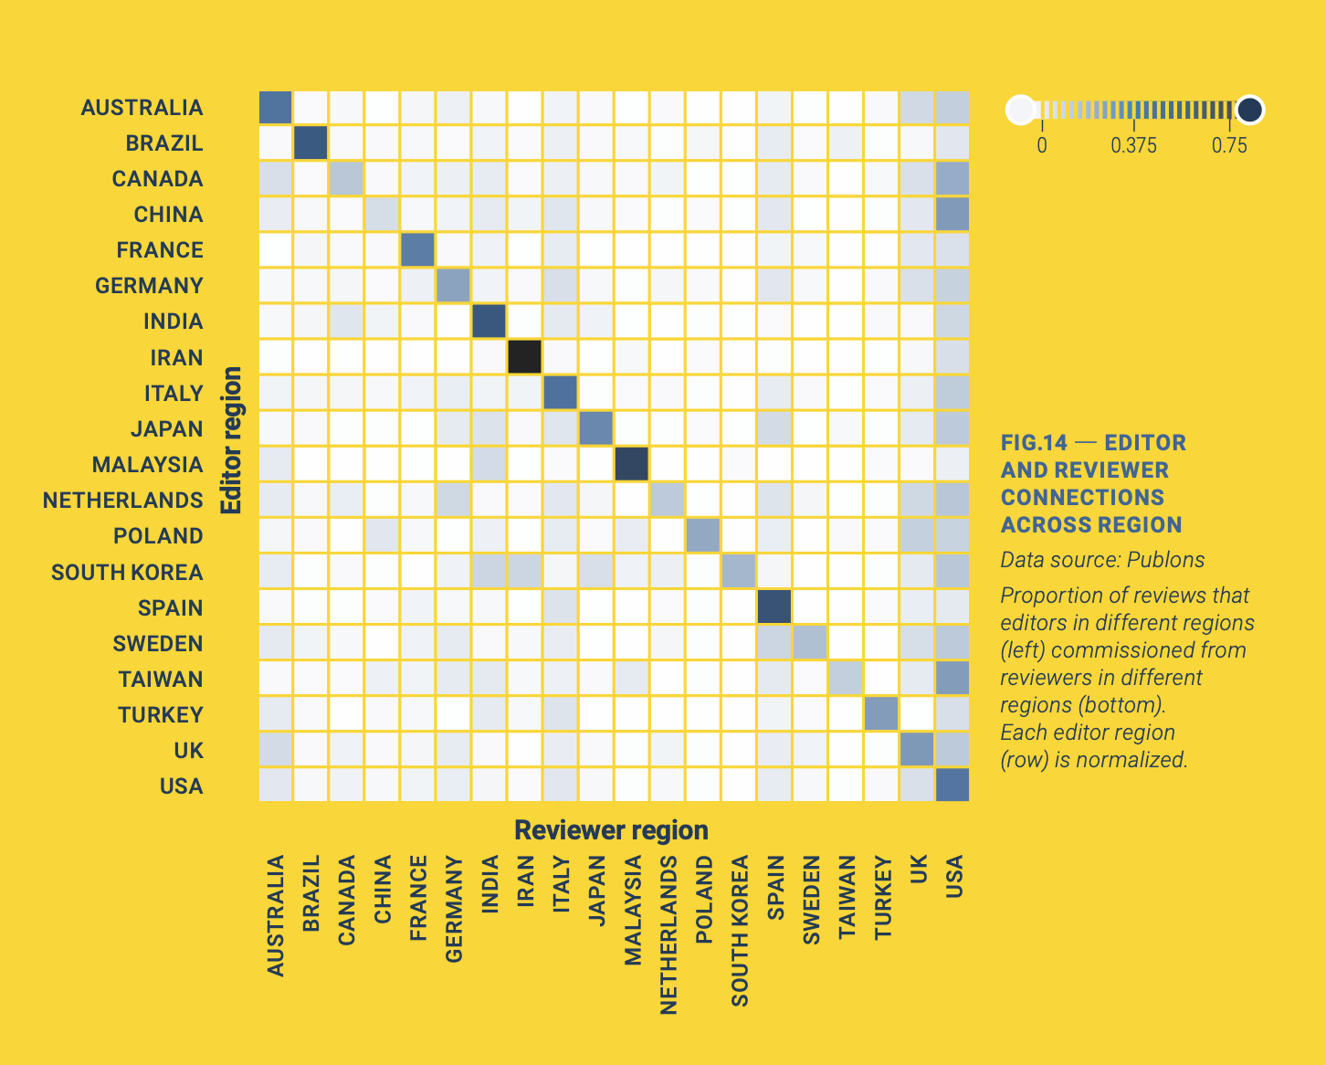
38% of all reviews involve an editor and reviewer from the same region.
Publons Global State of Peer Review Report (2018)
Notes:
…and editors predominantly select reviewers from their own regions, despite the fact that reviewers from emerging countries agree to review more often and complete reviews faster. This suggests that they are under-represented because they are not asked to review. 38% of all reviews involve an editor and reviewer from the same region. If editors selected reviewers proportionally to the amount of reviews a region completes that number should be 14%.

Slide 6
Supply =
reviews
completed
Demand =
manuscripts
submitted
25
12.5
20
10
15
7.5
Supply of reviews (millions)
Demand of reviews (millions)
10
5
5
2.5
0
0
Publons Global State of Peer Review Report (2018)
Notes:
And while the data so far are for all the sciences combined the journal CogSci pretty much aligns with this trend if we look at the editors and the Board of Reviewers …

Slide 7
Supply =
reviews
completed
Demand =
manuscripts
submitted
25
12.5
20
10
15
7.5
Supply of reviews (millions)
Demand of reviews (millions)
10
5
5
2.5
0
0
Publons Global State of Peer Review Report (2018)
Thanks to Rick Dale for compiling the reviewer figures!
Notes:
…and at the journal reviewers. However, my interactions with the journal editors-in-chief both for CogSci and for TopiCS revealed that they are very mindful of this imbalance and are trying to mitigate it by emphasising diversity to topic editors.

Slide 8
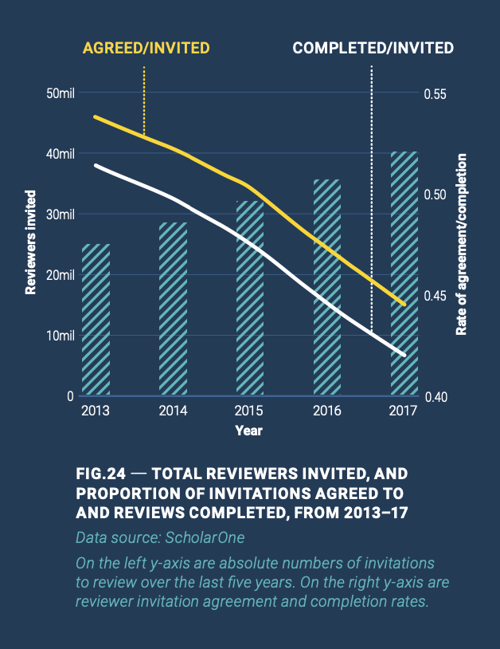
invitations / review:
2013: 1.9
2017: 2.4
Publons Global State of Peer Review Report (2018)
Fox et al., 2017
Notes:
Not only are reviewers disproportionally selected frome established regions but there is also growing reviewer fatigue. While review invitations steadily increase due to an increase in scientific outputs number of agreed and, even more so, completed reviews has decreased over time.

Slide 9
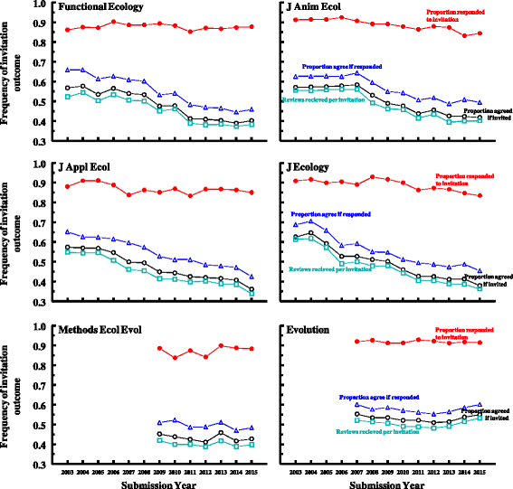
Publons Global State of Peer Review Report (2018)
Fox et al., 2017
Notes:
Here are some examples from Biology journals showing that this trend has been going on for some 15 years.

Slide 10
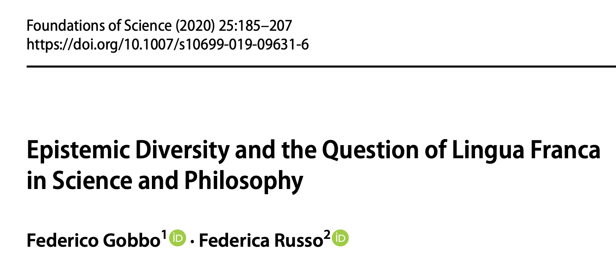
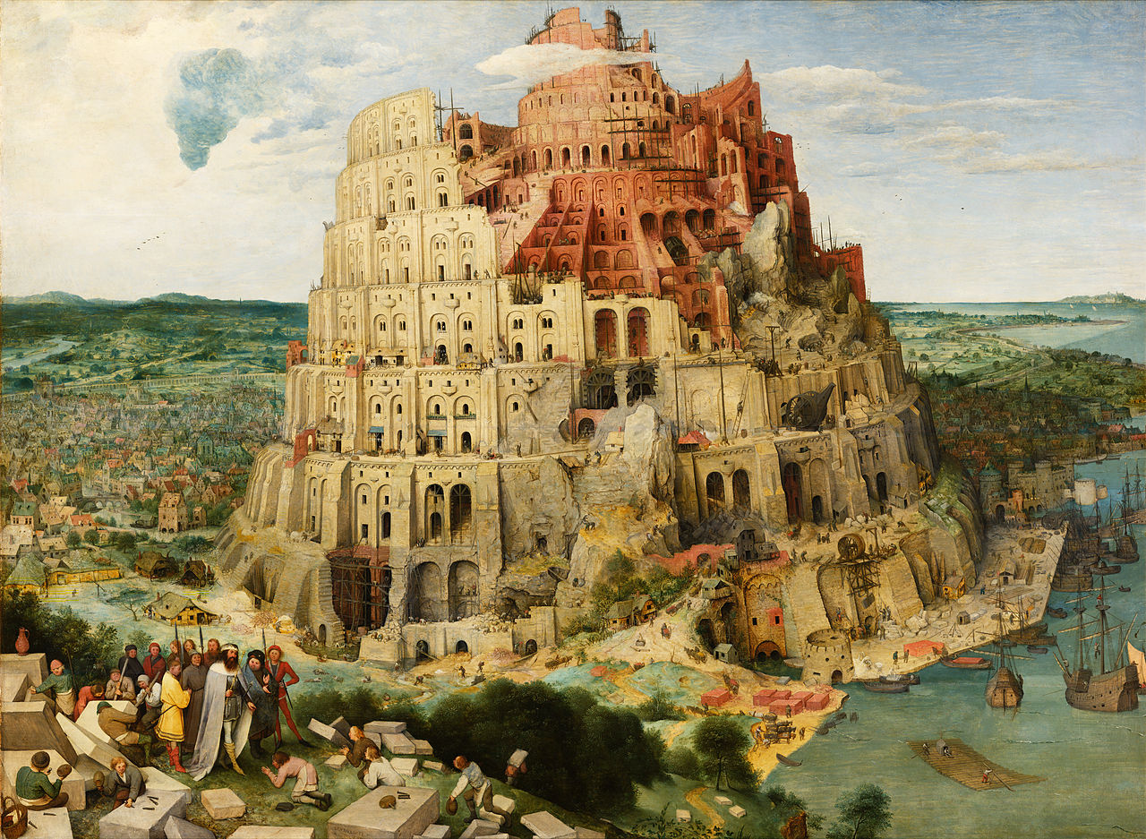
Notes:
It is no secret that all so-called ‘international’ journals publish in English. Some may argue that having a lingua franca facilitates international collaboration and global science and allows us to build that provervial tower to heaven.

Slide 11
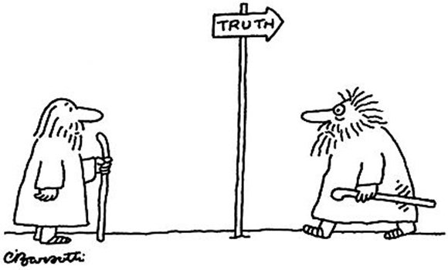


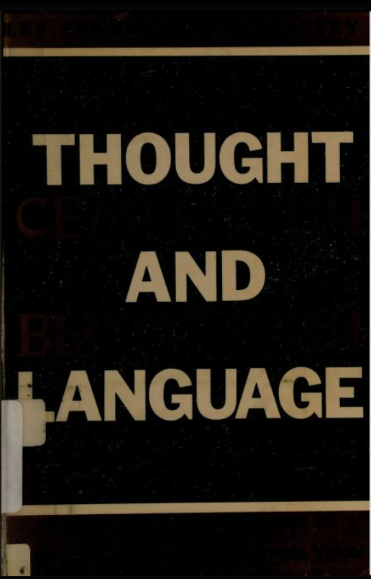
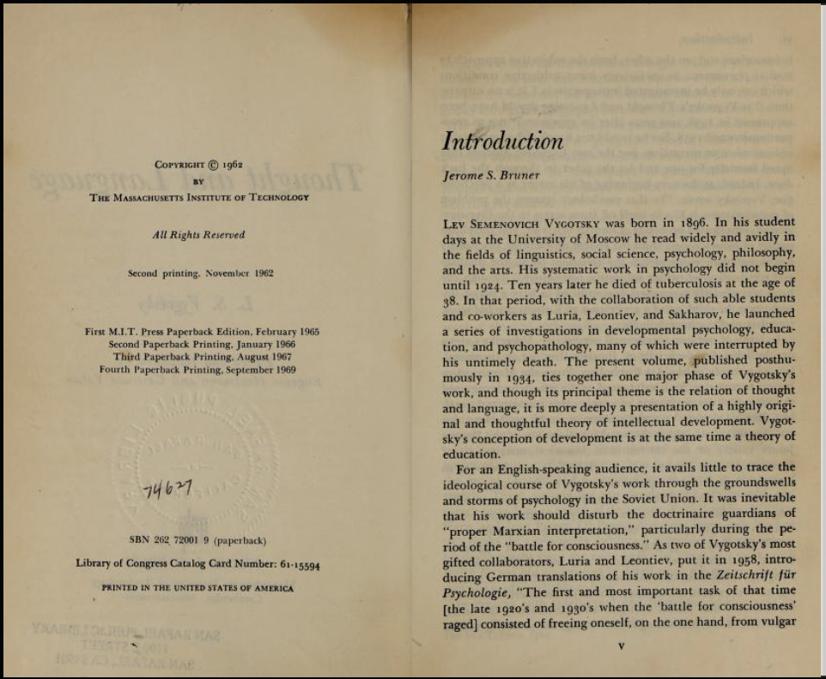
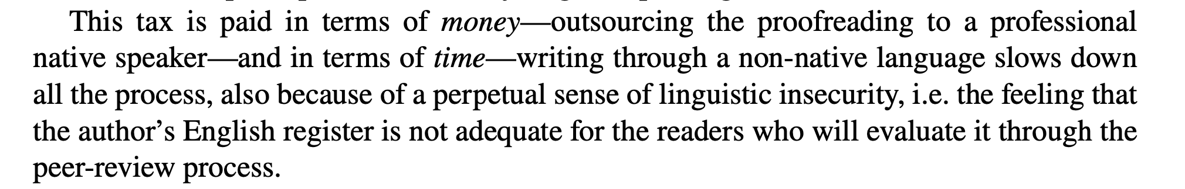
Reduced epistemic diversity
Tyranny of tradition
Linguistic injustice
Lev Vygotsky
1896-1934
Notes:
At the same time, the use of English may be associated with a range of problems we may not sufficiently reflect on:
Reduced epistemic diversity: Different languages come with different cultural connotations and epistemic traditions; English imposes one specific epistemic tradition, aligned with analytic philosophy and logical positivism and a specific view on what constitutes knowledge and how to obtain it.
Tyranny of tradition: English bibliographies limit/eliminate reading of works in other languages – it took the West ~30 years to discover Vygotsky.
Linguistic injustice: English language outputs incur greater costs in terms of time and money for authors who are non-native English speakers. It may also affect how their work is reviewed.

Slide 12
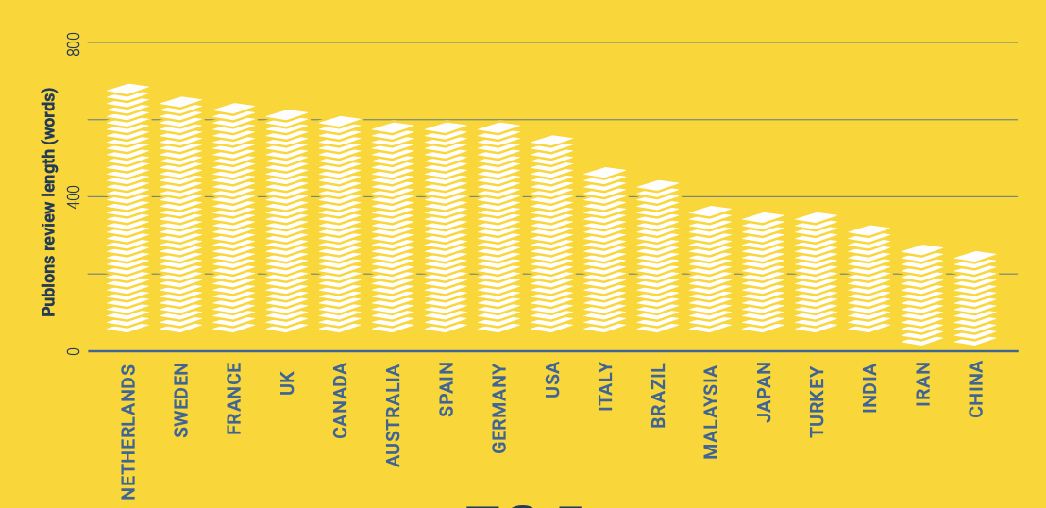
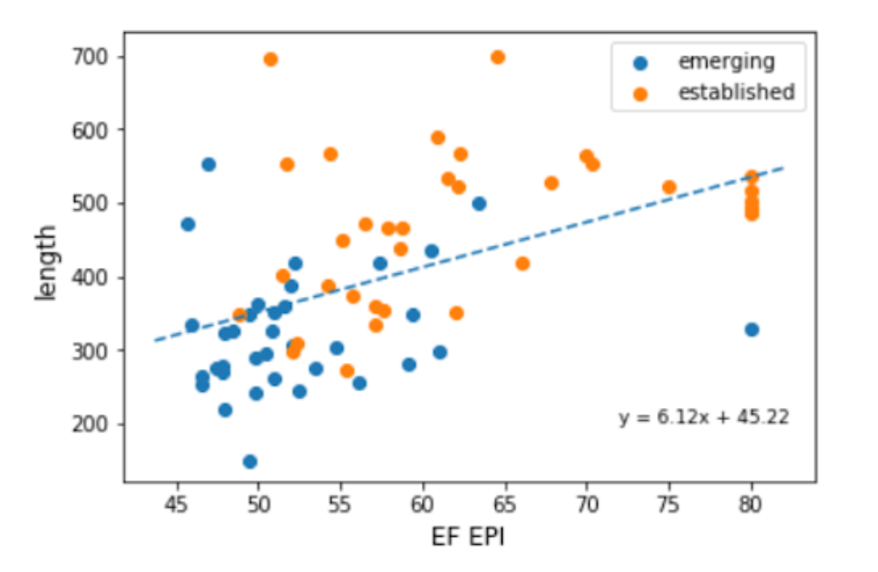
Review Length by Country
Review Length by
Country’s English Proficiency
English proficiency index by country
Xu et al. (2019)
Notes:
The PUBLONS review also observed that while reviewers from emerging regions generally tend to agree to review more often and complete reviews slightly faster they tend to submit shorter reviews. Review length is of course a poor proxy for review quality but it may highlight the need to structure and streamline the review process and to educate a broader reviewer base.

Slide 13
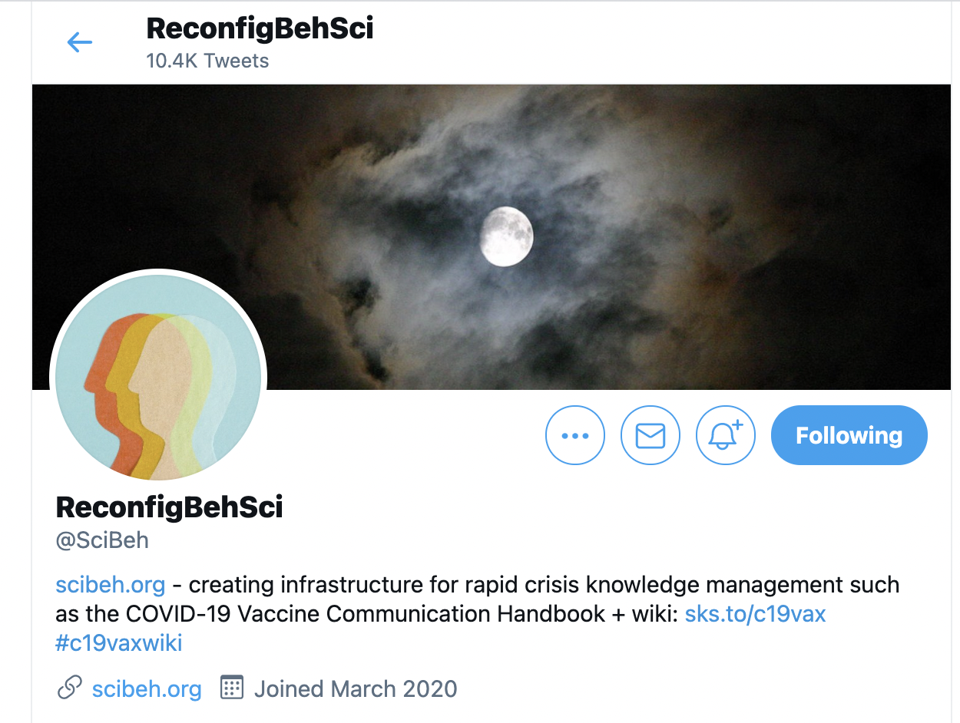
An Initiative
November 2020 @SciBeh hackathon to create a Peer Review Rubric to streamline the (preprint) review process.
Feasibility testing currently underway
Purpose:
Make it easier to perform more rapid quality control of preprints to broaden the pool of reviewers.
Educate students and early-career researchers in peer review.
Provide meta-data that will in future allow for automatised extraction and aggregation of data on current research.
Function as quality check for journalists, policy-makers and the public interested in the most recent findings.
Holford, D. L., Holcombe, A., Puebla, I., Kempe, V. & McLean, J. F. (in prep.)
Notes:
These trends together suggest some urgency to broaden all aspects of scientific publishing internationally. In order to broaden the reviewer base and to address the problem of reviewer fatigue the @SciBeh initiative is working on creating a Peer Review Rubric that can help to streamline the process, educate students and ECRs in peer review and also to collect meta-data about preprints. However, in streamlining the peer review process it may constrain epistemic diversity even more – a trade-off to be discussed further.

Slide 14
Poll on Discussion Points
In your experience, is language a problem for submitting / reviewing?
Can we connect with non-English-speaking scientists (authors / reviewers)? How?
Should we make efforts to process the non-English scientific literature? How?
How widespread and systematic is reviewer training for PhD students, postdocs and ECRs worldwide?
How can editors be supported to cast a wider net of review invitations?

Slide 15
References
Fox, C. W., Albert, A. Y., & Vines, T. H. (2017). Recruitment of reviewers is becoming harder at some journals: A test of the influence of reviewer fatigue at six journals in ecology and evolution. Research Integrity and Peer Review, 2(1), 1-6.
Gobbo, F., & Russo, F. (2020). Epistemic diversity and the question of Lingua Franca in science and philosophy. Foundations of Science, 25(1), 185-207.
Publons Global State of Peer Review Report (2018)
Xu, S., Zhang, G., Sun, Y., & Wang, X. (2019). Understanding the peer review endeavor. Proceedings of the Association for Information Science and Technology, 56(1), 316-325.

